Slide 1
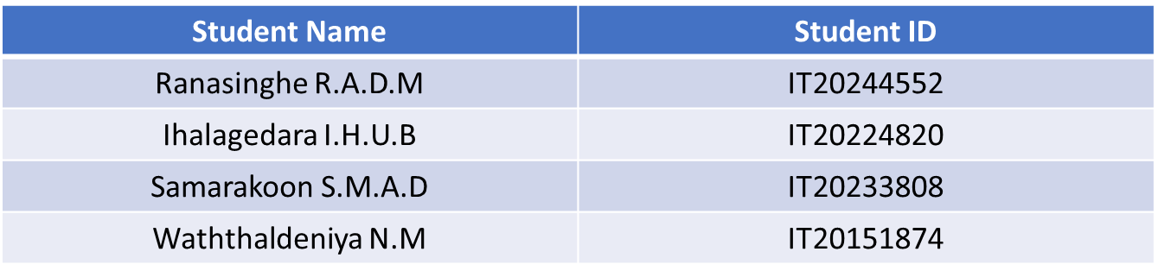
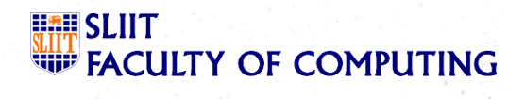
SMART SYSTEM FOR OPTIMIZED ORGANIC CROP ROTATION USING PRECISION AGRICULTURE DATA
PROGRESS PRESENTATION 1
2023-113
Student Name
Student I
Project ID: TMP-23-113
05/23/2023
1

Slide 2
Objectives
Specific Objective: The main objective of this system is to provide the opportunity for the stakeholders to create their crop rotation plan with the help analysis of soil, climate and pests and also provide other agriculture supports.
Sub Objective :
Gather soil data using IoT device and use it as parameters in an algorithm
Identify the pests and diseases based on the provided image and provide solutions through an algorithm.
Gather climate data using IoT device and use it as a parameters in an algorithm
Project ID: TMP-23-113
05/23/2023
2

Slide 3
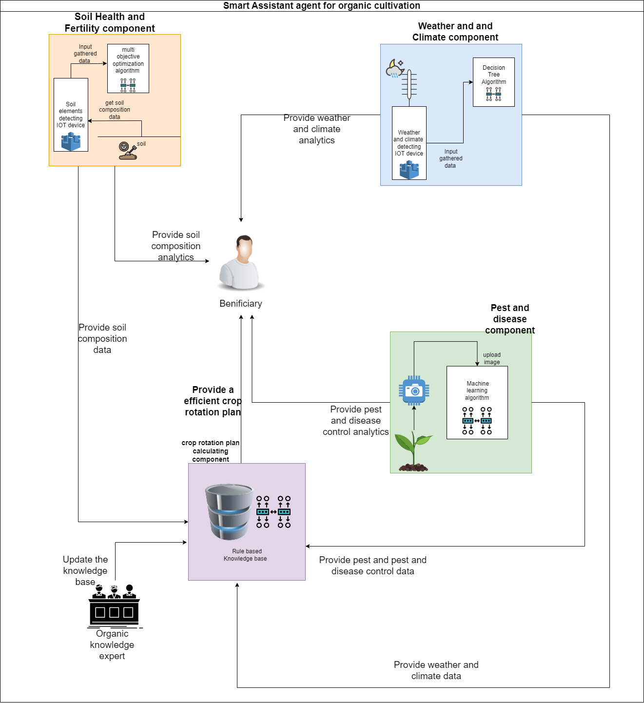
Proposed System Overview Diagram
Project ID: TMP-23-113
05/23/2023
3

Slide 4
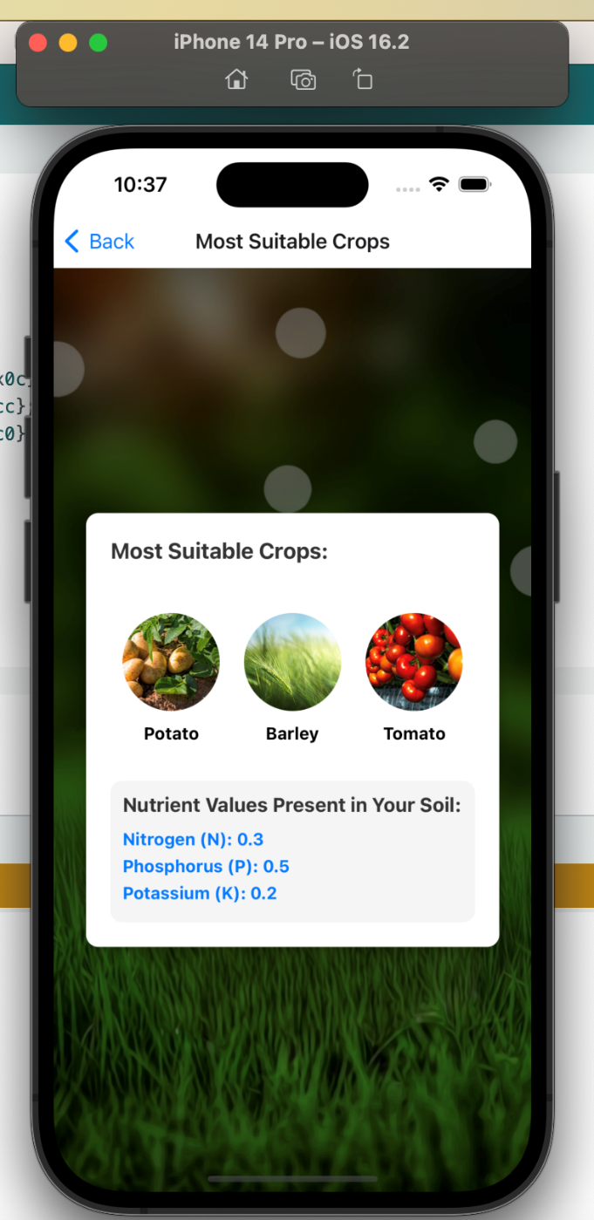
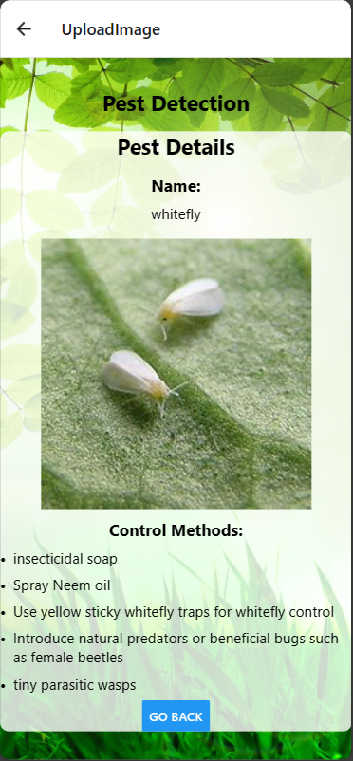
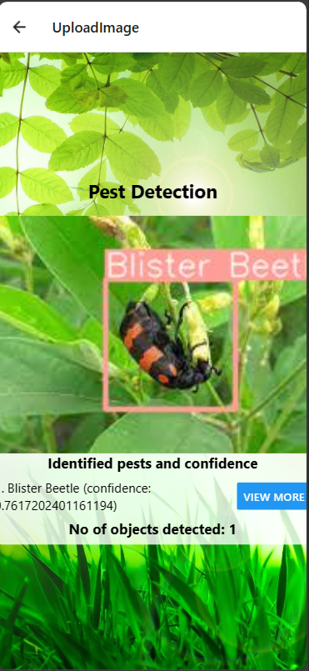
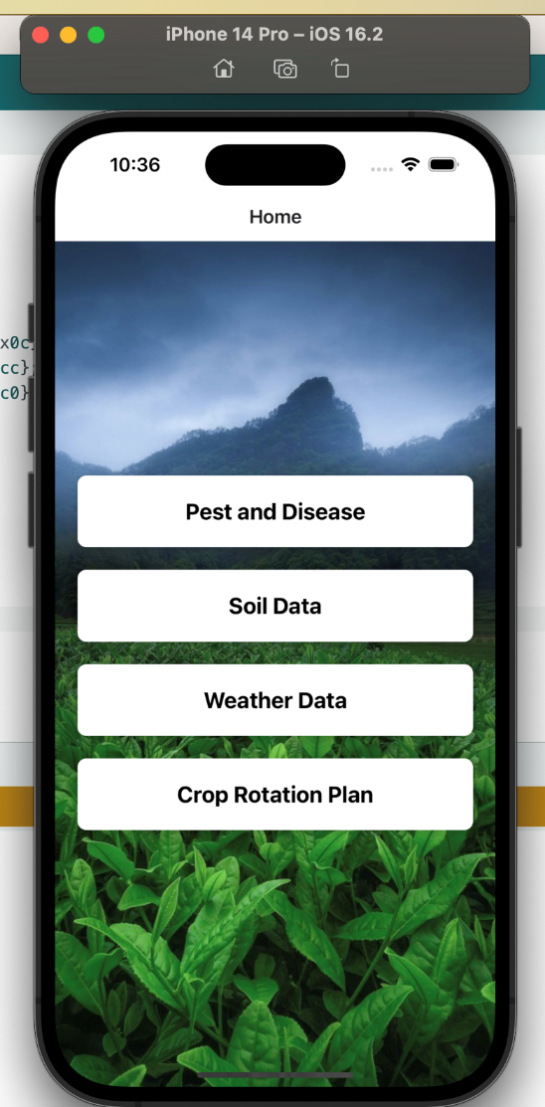
System Applications
Project ID: TMP-23-113
05/23/2023
4

Slide 5
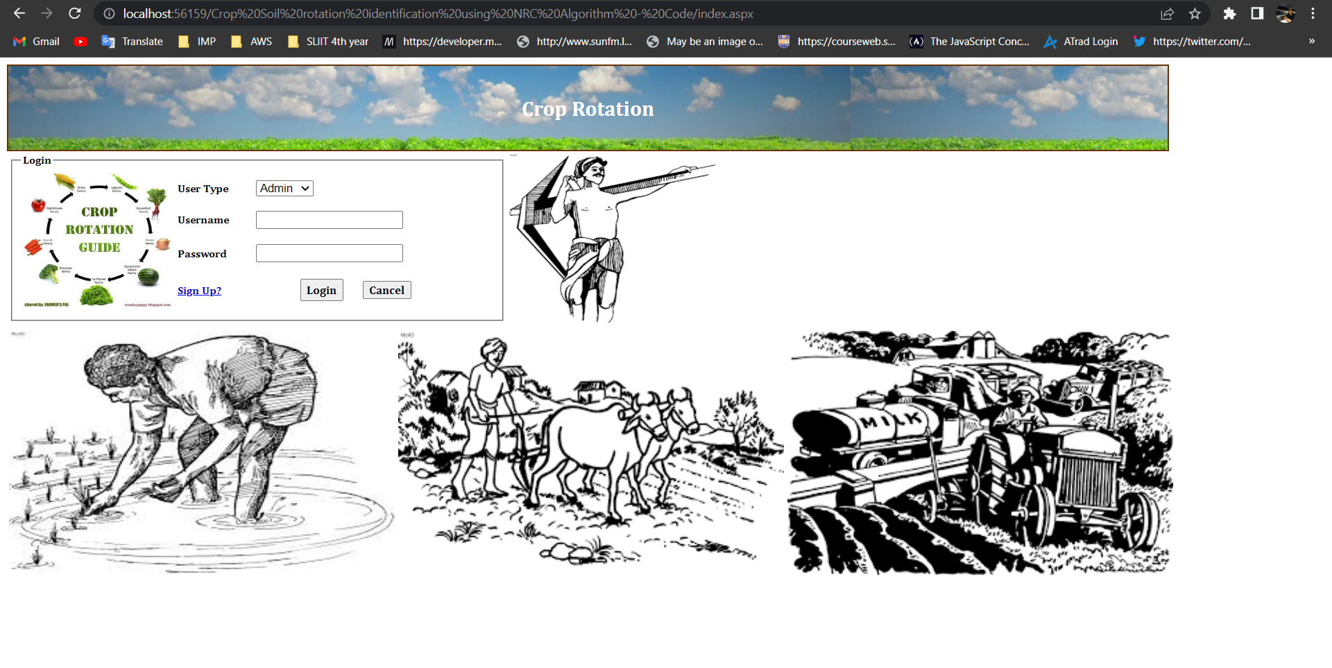
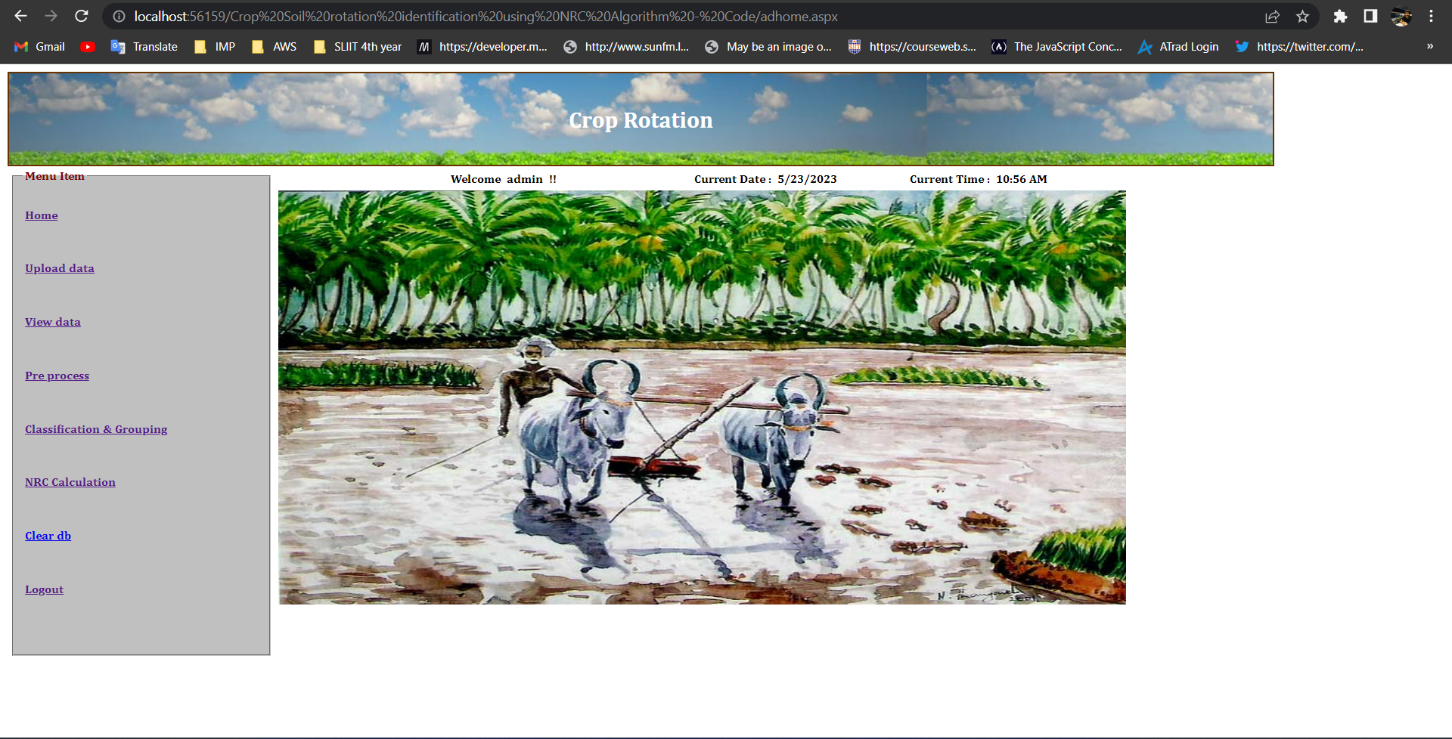
System Applications
Project ID: TMP-23-113
05/23/2023
5

Slide 6
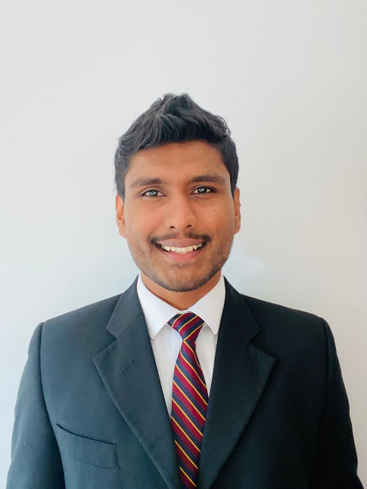
IT20244552 | Ranasinghe R.A.D.M.
Bachelor of Science (Hons) in Information Technology Specializing in Software Engineering
IT20244552 | Ranasinghe R.A.D.M. | Project ID: TMP-23-113
05/23/2023
6

Slide 7
Target Problem
Problem: No existing software solution utilizes precision agriculture data for crop rotation planning.
Crop rotation is crucial for soil health, pest management, and maximizing yields.
Current agricultural software lacks integrated crop rotation planning capabilities.
Farmers manually collect and analyze data, leading to suboptimal decisions and reduced yields.
IT20244552 | Ranasinghe R.A.D.M. | Project ID: TMP-23-113
05/23/2023

Slide 8
Target Solution
Solution: Develop a software tool that leverages precision agriculture data for optimized crop rotation plans.
Benefits: Improved decision-making, increased productivity, and enhanced sustainability.
Factors considered: Soil health, Weather Management, pest management, market demand.
Powering efficient and sustainable farming practices through technology.
IT20244552 | Ranasinghe R.A.D.M. | Project ID: TMP-23-113
05/23/2023

Slide 9
CURRENT PROGRESS – IT20244552 (50%)
Created the crop rotation algorithm to produce the crop rotation plan
Implemented the web application that Agri experts are going to use(Admin panel)
Implemented a database to store the new dataset
Implanted the user interface using ASP.NET
IT20244552 | Ranasinghe R.A.D.M. | Project ID: TMP-23-113
05/23/2023

Slide 10
NEXT EXPECTED PROGRESS (100% COMPLETION) IT20244552
Add the calculate crop rotation plan feature to the mobile application.
Remodify the data set
Remodify the crop rotation plan algorithm to consider the previous crops and disease
IT20244552 | Ranasinghe R.A.D.M. | Project ID: TMP-23-113
05/23/2023

Slide 11
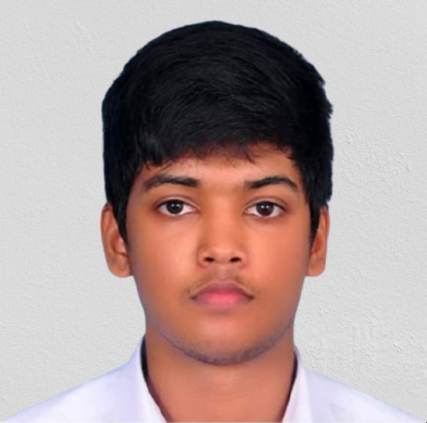
IT20233808 Samarakoon S.M.A.D
Bachelor of Science (Hons) in Information Technology Specializing in Software Engineering
05/23/2023
11
IT20233808 | Samarakoon S.M.A.D. | Project ID: TMP-23-113

Slide 12
Target Problem
Target problem –
In the current market there isn’t a software solution which uses a IOT devices with a machine learning model along with decision making algorithms to find the most optimized crop for a particular soil to gain high yield with low fertilizers.
Proposed solution –
To develop a system which uses IOT devices to gather required data and use those data to create a training dataset which will be then use to train machine learning model to predict the most optimized crop for given soil sample
05/23/2023
IT20233808 | Samarakoon S.M.A.D. | Project ID: TMP-23-113

Slide 13
CURRENT PROGRESS – IT20233808 (50%)
Created the IOT devices to gather soil data required for decision making algorithm.
Completed the decision algorithm to find out the most optimized crop for a particular soil.
Implemented a decision algorithm in a flask server.
Implemented the react native mobile app to display most suitable crop.
Configured the IOT device with the mobile application to get real time soil.
Trained a random forest model to find the most optimized crop using the training data gathered from the decision algorithm and from a externally gathered data set
IT20233808 | Samarakoon S.M.A.D. | Project ID: TMP-23-113
05/23/2023

Slide 14
NEXT EXPECTED PROGRESS (100% COMPLETION) IT20233808
Using IOT devices for gtaher real time soil data
Integrating IoT devices with optimization algorithms for crop selection
Software solution that equipped with IOT devices to suggest crops using Multi objective optimization techniques.
05/23/2023
IT20233808 | Samarakoon S.M.A.D. | Project ID: TMP-23-113

Slide 15
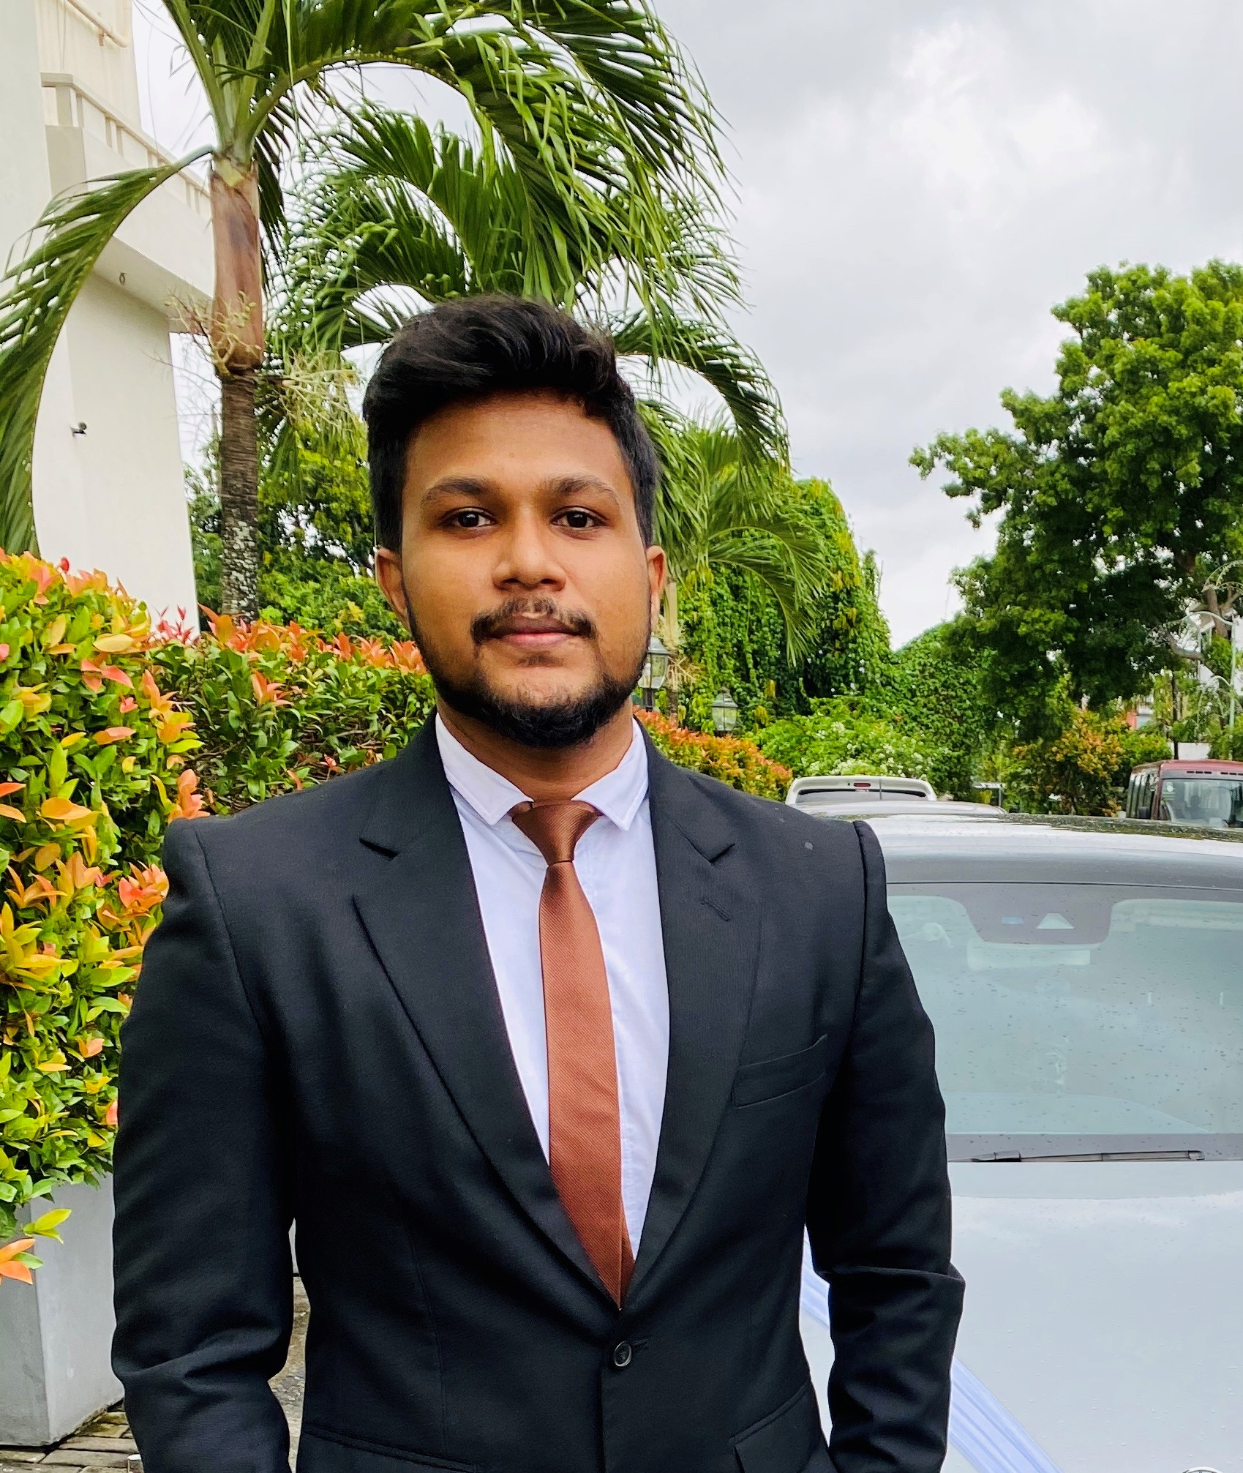
IT20224820 | Ihalagedara I.H.U.B
Bachelor of Science (Hons) in Information Technology Specializing in Software Engineering
IT20224820 | Ihalagedara I.H.U.B | Project ID: TMP-23-113
05/23/2023
15

Slide 16
Target Problem
Target problem –
Provide the users with the knowledge about pest and the organic pest controlling solutions. None of the available systems are capable of identifying pests with the concept of augmented reality and Sri Lankan based organic solution providing mechanism.
Proposed solution –
Proposed solution is to provide a pretrained system to identify pests and provide them with the solutions. The concept of augmented reality is used to identify the objects and it would be more convenient and efficient to use.
IT20224820 | Ihalagedara I.H.U.B | Project ID: TMP-23-113
05/23/2023

Slide 17
CURRENT PROGRESS – IT20224820 (50%)
Gather dataset and preprocess the data to be more useful.
Data augmentation and noise reduction.
Train a model with the data set which is capable of identifying 15 different classes of pests with the YOLO algorithm.
Create a flask server and use the created best model to get the predictions.
Create a react native user interfaces and use the created API's to get objects detected using the flask server and upload the to cloud.
Get the results with the bounded image and display it.
IT20224820 | Ihalagedara I.H.U.B | Project ID: TMP-23-113
05/23/2023

Slide 18
NEXT EXPECTED PROGRESS (100% COMPLETION) IT20224820
Usage of a system to provide nonchemical and organic solutions to help the crop rotation in Sri Lanka.
Identifying the pests through the augmented reality and provide the traditional and organic solutions.
Create a model to provide the most suitable solutions based on the user surrounding data.
Creation functionality to self-optimize the dataset based on the usage of the application
Deploy the flask server and the react native in the cloud environment.
IT20224820 | Ihalagedara I.H.U.B | Project ID: TMP-23-113
05/23/2023

Slide 19
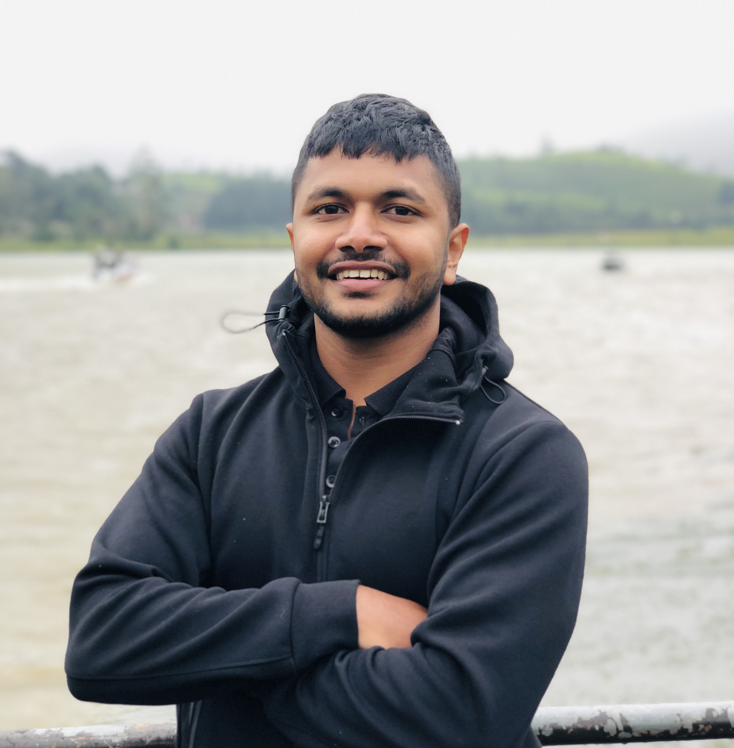
IT20151874 | Waththaladeniya N.M
Bachelor of Science (Hons) in Information Technology Specializing in Software Engineering
IT20151874 | Waththaladeniya N.M | Project ID: TMP-23-113
05/23/2023
19

Slide 20
Target Problem
Target problem -
Current marketplace does not contain a way to identify the real time weather like humidity and temperature using IOT device and get the suitable crop and various information about the crop.
Propose system -
To develop a system which can identify suitable crop based on the area weather condition and give various information about crops.
IT20151874 | Waththaladeniya N.M | Project ID: TMP-23-113
05/23/2023

Slide 21
Current progress
Configure IOT device to identify the weather condition like temperature and humidity.
Trained data model using decision tree algorithm to recommend the crop based on the weather data.
Implemented the trained model in flask server.
Implemented the react native mobile app to display most suitable crop.
IT20151874 | Waththaladeniya N.M | Project ID: TMP-23-113
05/23/2023

Slide 22
Next Expected progress (100% completion) IT20151874
Integrate IOT data with application.
Improve the model using new parameters like, rainfall and wind.
Need to train data model to get various information of crop
Need to provide solution to reduce the impact on weather changes.
IT20151874 | Waththaladeniya N.M | Project ID: TMP-23-113
05/23/2023

